Slide 1






Introduction to Java EE
Java Platform, Java EE, Servlets, JSP
Java Web Dev Basics
SoftUni Team
Technical Trainers
Software University
http://softuni.bg

Slide 2




Table of Contents

Slide 3
Questions
sli.do #java-web

Slide 4
Java Platform
The Big Picture

Slide 5



Java - The Big Picture
The Java Technology is both a programming language and a platform
The Java programming language:
Object-oriented
C-like syntax
The Java platform:
Environment
Where Java applications run

Slide 6
Java - The Big Picture (2)
There are 4 Java platforms:
Java SE (Standard Edition)
Java ME (Micro Edition)
Java FX (Effects)
Java EE (Enterprise Edition)

Slide 7
Java - The Big Picture (3)
Each Java platform:
Provides a JVM & an API
Runs applications on any compatible system
Is completely independent
Provides all of the advantages of the Java programming language
Java SE
Java ME
Java FX
Java EE

Slide 8

Java Enterprise Edition
Diving into the depths of Java EE

Slide 9


Java Platform, Enterprise Edition
Java EE
Formerly (J2EE), Currently Jakarta EE
A set of specifications extending Java SE
Defined by its specification
Defines APIs and their interactions
Used in various contexts, including:
E-commerce, Accounting, Banking Systems, etc.

Slide 10


Java EE vs Java SE
Java SE
Provides APIs to handle collections
JVM is the container for Applications
The container provides lower-level services
Java ЕE
Provides APIs to handle transactions, persistence, security, messaging, etc.
Applications are ran on a specific container
The container provides higher-level services

Slide 11

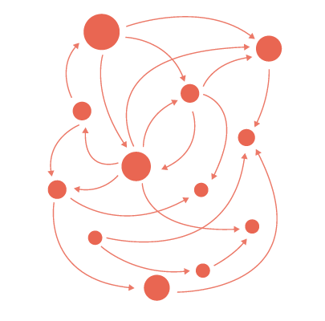

Java EE simplifies
Enterprise Applications:
Have powerful functionalities
Tend to be heavy and complex
Java EE reduces complexity
Provides a programming model
Provides a Runtime environment
Provides various APIs

Slide 12





Java EE Architecture
Container
Services
Provides
Provides
Managing
Deployment
Consumed by
Packaging
APIs
Applications

Slide 13

Apache Tomcat

Slide 14





What is a Apache Tomcat?
Open-source Java Servlet Container
Developed by the Apache Software Foundation
Implements Java Servlet, JSP, Java EL, WebSockets
Provides a pure Java HTTP Server

Slide 15
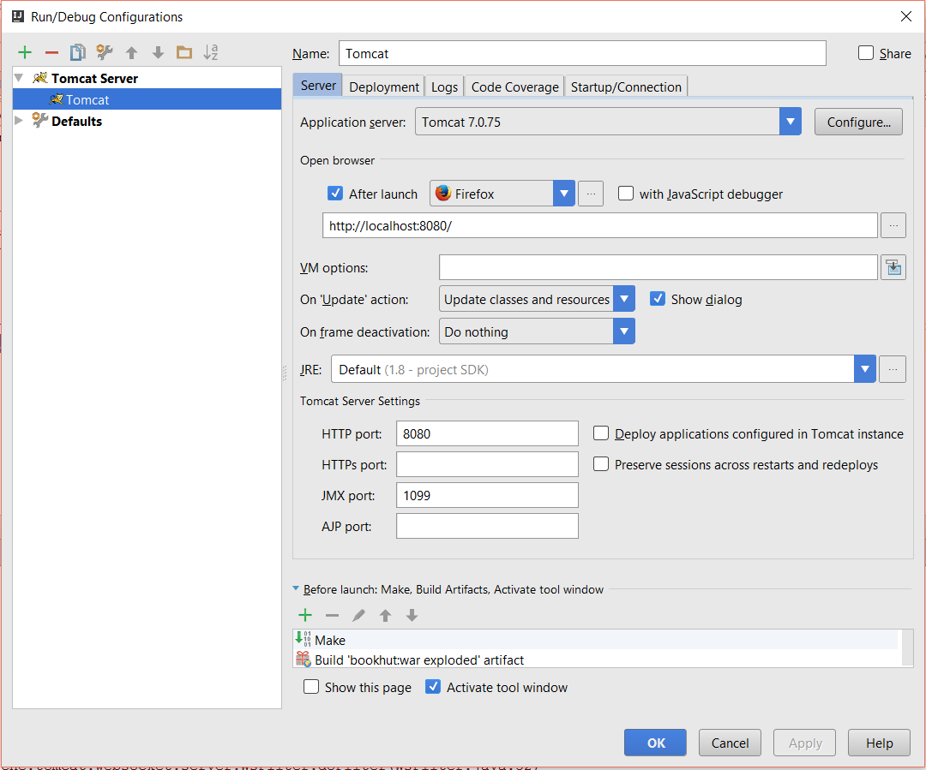

Tomcat Setup
Add Tomcat
Tomcat Server
URL
Default Action
HTTP Port

Slide 16
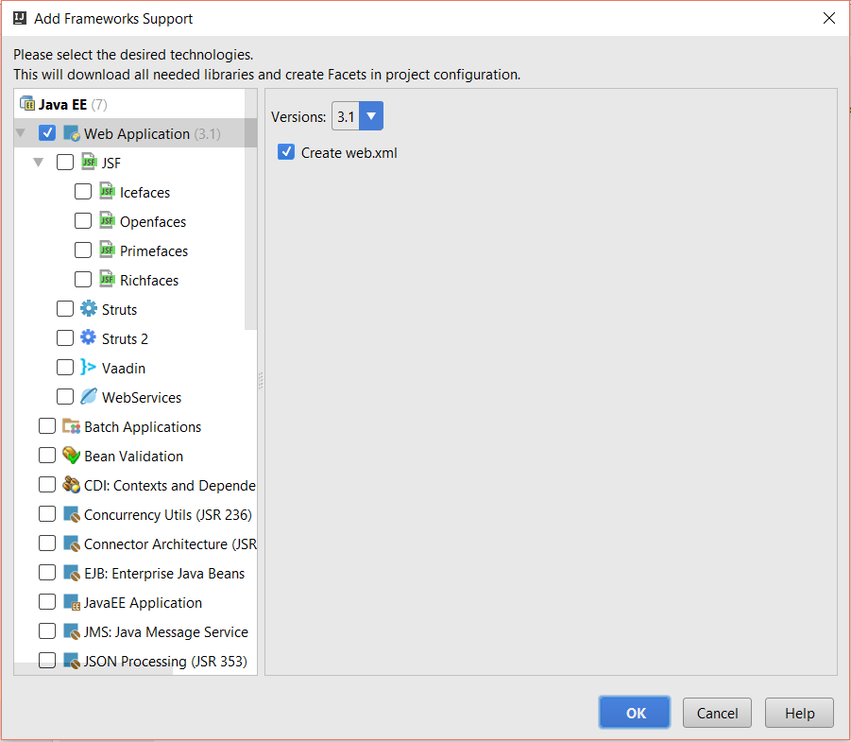
Java EE Support
Web Support
Web XML

Slide 17


Slide 18
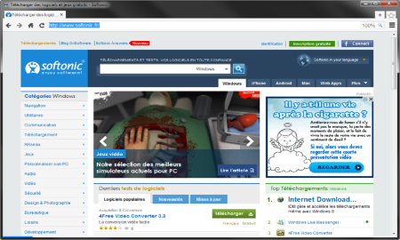





Java Servlets
Programs that run on a Web/Application server
Extend the capabilities of a Server
Able to respond to any type of request
Web Client
Web Server
Request
Request
Servlet
Database
Data
Response
Response

Slide 19

Maven Dependencies
pom.xml
<dependency>
<groupId>javax</groupId>
<artifactId>javaee-api</artifactId>
<version>8.0</version>
</dependency>

Slide 20
Servlet Example
URL pattern
Servlet.java
@WebServlet("/home")
public class Servlet extends HttpServlet {
protected void doPost(HttpServletRequest request,
HttpServletResponse response)
throws ServletException, IOException {
}
protected void doGet(HttpServletRequest request,
HttpServletResponse response)
throws ServletException, IOException {
}
}
Handle Post requests
Handle Get requests

Slide 21
Servlet Lifecycle
Java Virtual Machine
Web Server
Servlet Container
Thread 1
init()
Thread 2
service()
Thread 3
destroyed()
Requests

Slide 22
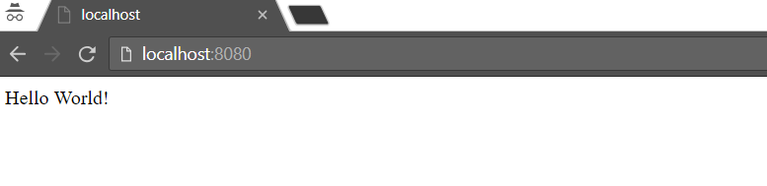
Hello World!
Servlet.java
@WebServlet("/header")
public class Servlet extends HttpServlet {
protected void doGet(…) {
PrintWriter out = response.getWriter();
out.println("Hello World!");
}
}

Slide 23
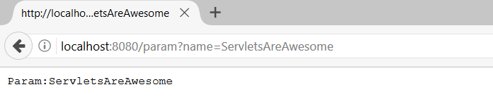
Read Parameter
Servlet.java
@WebServlet("/param")
public class Servlet extends HttpServlet {
protected void doGet(…) {
PrintWriter out = response.getWriter();
String name = request.getParameter("name");
out.println("Param:" + name);
}
}
Param name
Param name

Slide 24
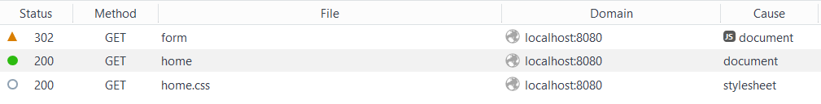
Redirect
Servlet.java
@WebServlet("/form")
public class Servlet extends HttpServlet {
protected void doGet(…) {
response.sendRedirect("/home"); }
}
Redirect to /home
Notes:
It is possible to invalidate a cookie by invoking the method languageCookie.setMaxAge(0);

Slide 25

JSPs

Slide 26
JSP
Technology for developing web pages that support dynamic content
JSP
Web Client
Read
Web Server
Request
Generate
Servlet
Response
Response

Slide 27
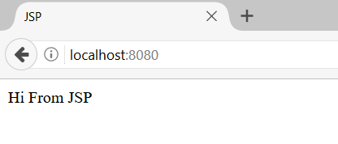
JSP Example
index.jsp
<%@ page contentType="text/html;charset=UTF-8" language="java" %>
<html>
<head>
<title>JSP</title>
</head>
<body>
<%= new String("Hi From JSP")%>
</body>
</html>
Page Directive
Java Code

Slide 28
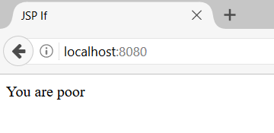
JSP Conditional Statement
index.jsp
<%@ page contentType="text/html;charset=UTF-8" language="java" %>
<html>
<body>
<%! int readBooks = 3;%>
<% if(readBooks < 20) {%>
<%= new String("You are poor")%>
<%} else {%>
<%= new String("You are rich")%>
<%}%>
</body>
</html>

Slide 29


Summary
The Java Technology:
A platform and a programming language
Java EE – The Big Picture:
The Java EE Architecture
What are Servlets?
What are JSPs?

Slide 30







Java Web Dev Basics – Introduction to Java EE
https://softuni.bg/courses/java-web-development-basics

Slide 31






SoftUni Diamond Partners

Slide 32






SoftUni Diamond Partners

Slide 33
License
This course (slides, examples, demos, videos, homework, etc.) is licensed under the "Creative Commons Attribution-NonCommercial-ShareAlike 4.0 International" license

Slide 34





Trainings @ Software University (SoftUni)
Software University – High-Quality Education, Profession and Job for Software Developers
softuni.bg
Software University Foundation
http://softuni.foundation/
Software University @ Facebook
facebook.com/SoftwareUniversity
Software University Forums
forum.softuni.bg

